Slide 1

PMBOK Knowledge Areas
Elizabeth Harrin

Slide 2
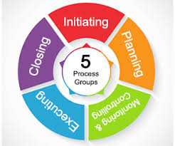
Project Phases (Process Groups)

Slide 3
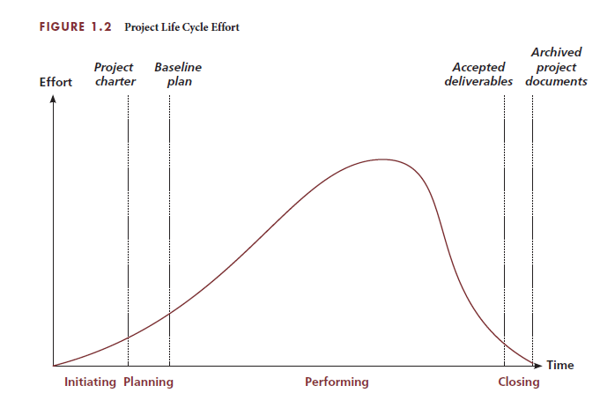
Project Phases (Process Groups)

Slide 4
Knowledge Areas: Definition
What exactly are ‘Knowledge Areas’?
And why are they so important they have capital letters?
PMI defines a Knowledge Area in the PMBOK® Guide — Sixth Edition Glossary like this:

Slide 5
Knowledge Areas: Definition
How many knowledge areas are there in project management?
What are the project management Knowledge Areas?

Slide 6
Knowledge Areas: Definition
An identified area of project management defined by its knowledge requirements and described in terms of its component processes, practices, inputs, outputs, tools, and techniques.
Basically, each Knowledge Area (which you might see abbreviated to KA) is a category of concepts and processes with a common goal.
All the things you need to know and do for successful risk management, for example, are bundled under the Risk Management Knowledge Area.

Slide 7
How many knowledge areas are there in project management?
According to the PMBOK® Guide — Sixth Edition, there are 10.
However, as with any discipline that requires working with cross-functional teams, you may find in reality you need to draw on other areas in order to get the job done.

Slide 8
10 Knowledge Areas of Project Management
They appear in that order as there is some logic to how they map to the project lifecycle.
For example, it helps to know the scope of a project before you plan the schedule.
You need to know the resources before you communicate to them.
Regardless: if you are going for the PMP® exam, you will have to memorize the Knowledge Areas and make sure you know them in the correct order (i.e. the order in the list above).

Slide 9
What are the project management Knowledge Areas?
Integration Management
Scope Management
Schedule Management
Cost Management
Quality Management
Resource Management
Communications Management
Risk Management
Procurement Management
Stakeholder Management.

Slide 10
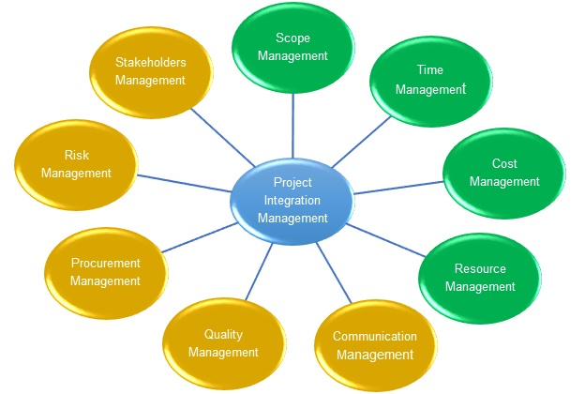
Knowledge Areas

Slide 11
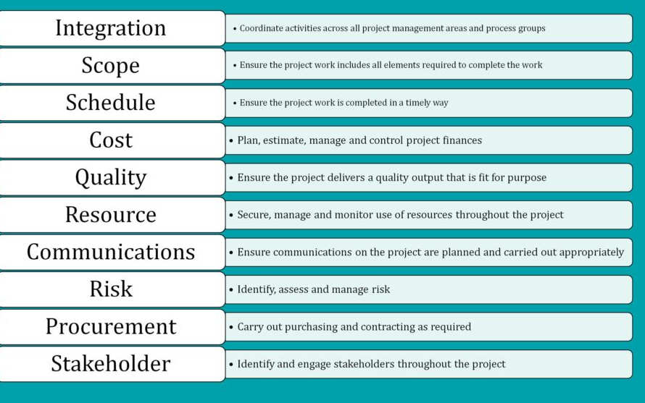

Slide 12
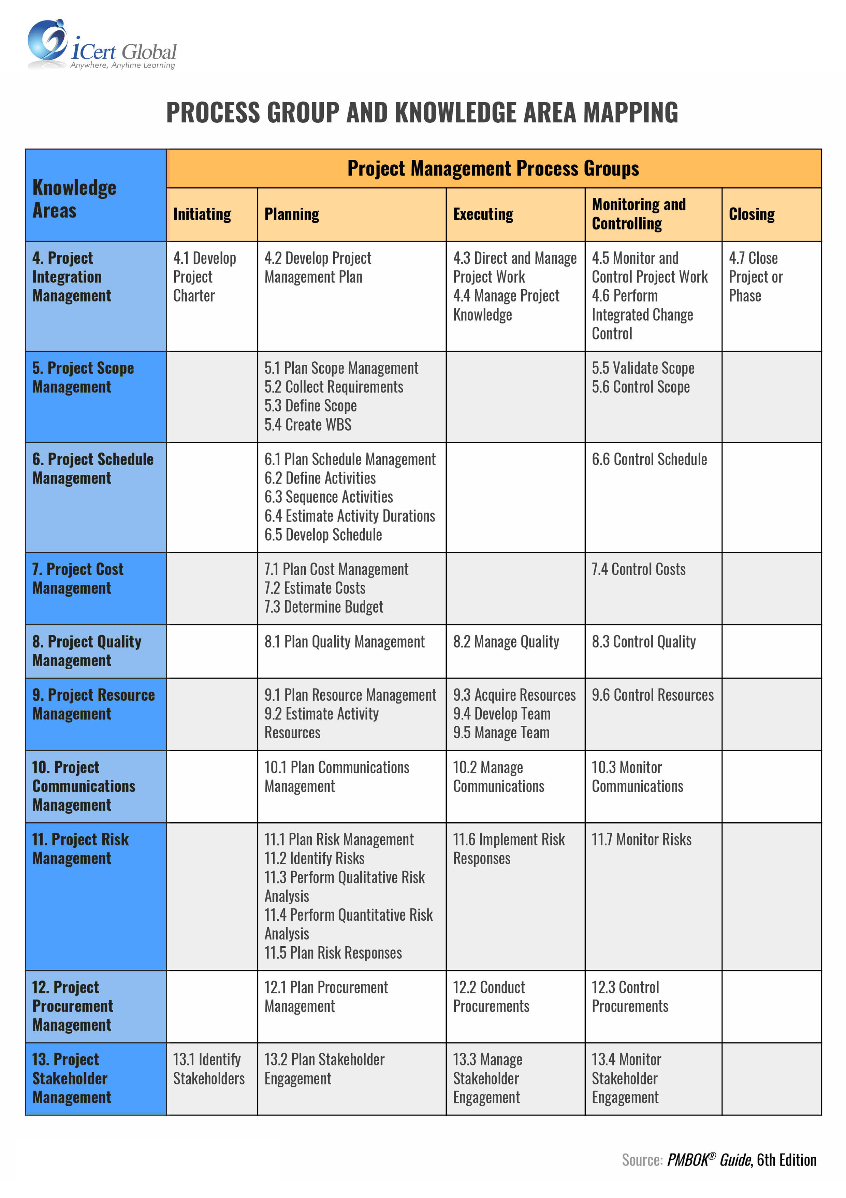

Slide 14
1. Integration Management
Project Integration Management is the hardest KA to get your head around because (in my opinion) it feels so vague.
The point of this whole Knowledge Area is to make it clear that everything about project management overlaps and needs to be managed as a holistic whole.
In other words, you can’t ‘do’ schedule management and ignore what the impacts of that might be on people, risk, communications, cost and the rest. This is the domain where you have to manage interdependencies between pretty much everything on the project.

Slide 15
2. Scope Management
This Knowledge Area looks at everything to do with managing project scope.
Ultimately, the end result is that once you have worked through the relevant processes, you know what the project is going to deliver.
That includes requirements (full or as full as is appropriate at this point in time) and a work breakdown structure if you use one.
Tip: Don’t get hung up on creating a WBS. If it isn’t a helpful tool for you, in real life you don’t have to use it! But you will need to know about them if you intend to go for the PMP® exam.

Slide 16
3. Schedule Management
Project Schedule Management is all about making a detailed plan to tell everyone when the project will deliver what is in the requirements.
Schedule management overlaps heavily with comms, as the timeline for the project is of major interest to stakeholders.
It’s a key document that you’ll use to manage stakeholders’ expectations.
And you use it to track progress.
There are a number of different techniques for tracking schedule progress including earned value management and percent complete.

Slide 17
3. Schedule Management
There is a whole other PMI practice standard for scheduling, so this KA doesn’t have a ton of detail in about the ‘how’.
In this KA, you cover everything to do with defining the work required to deliver the scope,
putting those tasks in the right order,
estimating how long they will take to do and,
building the project schedule.
The domain also covers keeping the schedule up to date.
You’ll often see schedule management and cost management on project management job descriptions, because they are the technical skills employers want to know you can do.

Slide 18
4. Cost Management
Cost management is basically managing project funding.
Under the umbrella of cost management, you will:
Plan how much you are going to approach budgeting
Estimate your costs
Create the project budget
Track and control the budget (using a budget tracking spreadsheet)
Many project managers on smaller projects don’t have the final say on how much money is allocated to their project, or final sign off on how it is spent.
Thought: This is unfortunate. If you are going to do the job, you should have authority to do it all.

Slide 19
4. Cost Management
However, I think many managers in the sponsorship role prefer to hold the purse strings themselves. It’s a shame, as they could delegate this to their project managers.
You need to understand how your organization expects you to handle finances on your project.
Whether it’s you raising purchase orders and approving invoices or your sponsor, get the process clear in your own head so that funding isn’t a cause of delay.

Slide 20
5. Quality Management
It would be nice to think that quality was something formal covered on every project, but in practice, and the experience of the project managers, quality isn’t often considered formally.
Obviously it depends on the project.
If you are opening a factory that makes bricks, you want every single brick to adhere to quality criteria that make it safe for building works.
Many knowledge work-related projects don’t take the same regimented approach to quality. However, it’s an important Knowledge Area to be aware of and use as appropriate to ensure a quality result on your project.

Slide 21
5. Quality Management
Project Quality Management involves:
preparing a quality management plan with metrics.
Then implement the plan,
carry out quality-related tasks and
making course-corrections as necessary to keep your project delivering the outputs you expect.

Slide 22
6. Resource Management
It’s the domain where you work out what you need to get the project done.
Resources are typically people but could also be other things like:
Equipment or vehicles
IT hardware and software
Materials like sand, gravel or other components
Facilities e.g. an office you have to rent for the duration of the project
Office gadgets like projectors.
Money is a resource as well. (If you don’t have the funding, you won’t be doing your project.)

Slide 23
6. Resource Management
This Knowledge Area covers:
planning how you are going to do resource management,
estimating what resources you need,
acquiring the resources you need and,
ensuring the physical resources you’re using are available as necessary.
You’ll also track the utilization of resources and take corrective action if necessary
for example if you’re getting through your resources at a quicker-than-planned rate.

Slide 24
6. Resource Management
The Resource Management Knowledge Area also covers developing your project team and managing the team.
Developing the team means:
Helping them improve their skills
Ensuring they can work together effectively
Creating an environment where the team can do their best work.
Managing the team means:
Tracking individual performance against planned work
Providing them with feedback on their contributions
Resolving problems individuals may have
Managing starters and leavers in the team so the team stays cohesive and changes don’t affect project performance.

Slide 25
6. Resource Management
That’s actually quite a lot for a project manager to do, especially if the people don’t work directly for you.
Just do your best and be aware that you set the tone for the team’s culture.
Teamwork is so important, so focus on what you can do to make your project team a great place to work. Keep morale and enthusiasm high.

Slide 26
7. Communications Management
In this Knowledge Area, you:
Create a communications management plan
‘Do’ communications i.e. carry out your plan, send briefings out, give presentations or whatever
Monitor the success (or otherwise) of those
Make changes as appropriate to ensure your next communications are effectively received and acted on.

Slide 27
8. Risk Management
There’s a whole PMI credential on risk management, so that tells you risk management is a big deal for project managers.
The Risk Management Knowledge Area covers an adequate overview of what you need to do to manage risk on your project.
Within this KA, you’ll be:
Planning how to manage risk on the project
Creating a risk management plan & Identifying risks
Analyzing risks (both qualitatively and quantitatively)
Planning the risk response based on your analysis
Carrying out the risk response activities
Monitoring risk to check the success (or otherwise) of your response activities, and taking action as necessary.

Slide 28
8. Risk Management
Basically, that’s the risk management process in a nutshell.
You’ll be managing risk the whole way through the project.
Anyone can raise a risk or take action to manage a risk.
Risk management is a team effort and this is a KA you’ll be using over and over again until it becomes second nature.

Slide 29
9. Procurement Management
If your project isn’t buying anything, you can skip this whole Knowledge Area in real life, although you’ll need to know it for the PMP® exam.
In the Procurement Management Knowledge Area, you:
Plan the procurements required and create a statement of work
Plan how you will make decisions about vendors
Carry out the procurement exercise to select a vendor
Manage the relationship with the vendor while they do the work
Close the procurement contract at the end of the work.

Slide 30
Procurement Management
Depending on what you are buying, and the type of organization you work in, you may have access to a specialist Purchasing team who can help with all of this.
There is a lot of contracting involved and those negotiations can be quite challenging if you aren’t used to being in that environment.

Slide 31
10. Stakeholder Management
Project Stakeholder Management is an extremely important Knowledge Area because projects are done through people.
Managing people could be viewed as a slightly arrogant way to think about the work done in this domain, so it may be preferable to think about it as stakeholder engagement.

Slide 32
10. Stakeholder Management
In this KA you:
Identify the people involved and affected by the project — the stakeholders
Plan how you are going to engage them in your work:
Create a stakeholder engagement plan
Manage the activities you are going to use to engage them, and
Gather feedback on whether the activities were successful or not.
Act on the feedback to improve your stakeholder engagement work for next time.

Slide 33
10. Stakeholder Management
This is also the area of the project where you are likely to have the most challenges, because people don’t act the way you sometimes expect them to. You’ll be dealing with:
conflict,
negotiating,
managing office politics.
This is also the domain where you are likely to be planning change management activities, if you don’t have a dedicated business change manager on the team.

Slide 34
10. Stakeholder Management
Stakeholder Management is the most interesting part of project management and can also see you at the table with the most senior managers in the company.
So it’s worth spending some time learning the tools and techniques to support how you get work done through others, because they are so critical to your success and the project’s success!

Slide 35
Summary
The PMI (Project Management Institute) has developed / coordinated the compilation of international best practice and published this as a guide.
The guide is the Project Management Body of Knowledge (PMBOK).
This guide enjoys widespread industry acknowledgement and the associated professional qualifications are highly desired and sought after.
The PMBOK defines 10 Knowledge Areas (KAs) that effectively scopes the knowledge requirements for contemporary project management.
Within each knowledge area, the guide defines several processes that must be followed. These are flexible, but they define how the knowledge areas are implemented.
Within the PMBOK, these processes are grouped together by Process Groups (PGs).
Note that the PMBOK is constantly evolving. Every 4-5 years an updated version is released that takes into consideration the latest developments in the field. It is every practitioners responsibility to keep up to date with these advancements.

